Slide 1
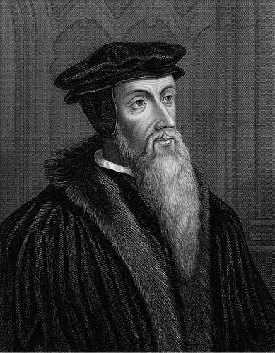
John Calvin
An Introduction

Slide 2
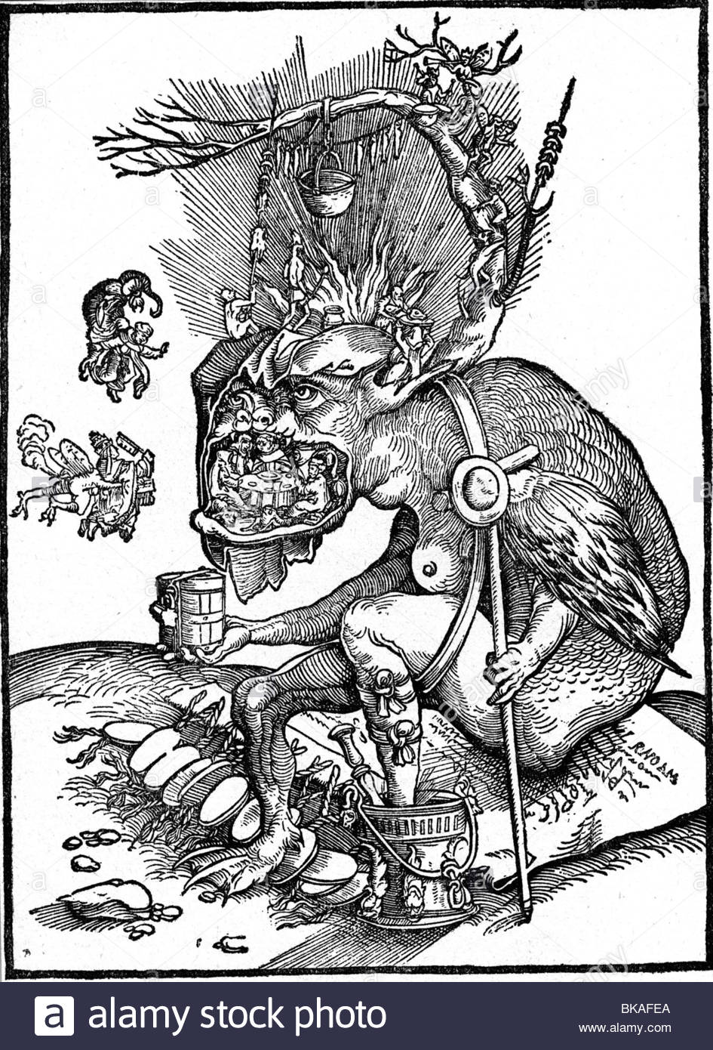

Slide 3
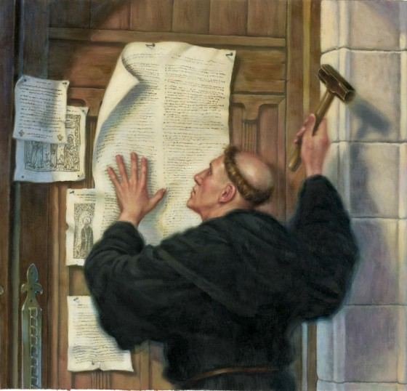
Introduction to the Reformation

Slide 4
Sixteenth Century Art
Pope depicted as the antichrist
The Catholic church (i.e. the people) locked in the jaws of the devil
Protestant reformers pictured as warriors wielding swords (i.e. the Word of God)

Slide 5
Characteristics of the Age
Anticlericalism
  Nepotism
  Simony
  Absenteeism
  Pluralism
  Concubinage

Slide 6
Characteristics of the Age
Anticlericalism (con’t)
  Indulgences
  Clerical illiteracy/ignorance of scripture
  Annates
  Clerical Exemptions

Slide 7
Characteristics of the Age
Changes by the magisterial reformers
  Rejected sacramental system
  Scripture is the final authority for faith and practice
  New Bible vernacular translations
  Altered Christian calendar
  Reordered Christian liturgy
  Redesigned interior of the church
  Redefined pastoral duties

Slide 8
Why study Calvin?
How is he different than Luther or Zwingli?
Different emphasis- worship

Slide 9

Calvin’s Biography

Slide 10
Early Life 1509-1536
Born in Noyon, France
Family
  Father: municipal clerk at local cathedral for bishop
  Mother: died when Calvin was 6 years old
  Siblings: five brothers and sisters

Slide 11
Early Life 1509-1536
Early preparation for career
  Tonsure: age 12, a sign of preparation for priesthood
  Benefice: age 12
  2nd benefice: age 20

Slide 12
Early Life 1509-1536
Studies in Paris
  Moves to Paris in 1523
  Enrolls at College de la Marche and later College de Montaigu
    Makes important friends: Pierre Oliventan; William and Nicholas Cop
  - Receives MA in philosophy in 1527 or 1528

Slide 13
Early Life 1509-1536
Legal Studies: Orleans and Bourge
  Father decides Calvin should persue law
  Discovery of humanism in Orleans
    Pierre de l’Estoile
    Melchior Wolmar
    Justinian Law Code
  Moves to Bourge in 1529 and studies under Alciat
  Receives doctorate in law in 1531

Slide 14
Early Life 1509-1536
Aspiring humanist
  Commentary on Seneca’s De Clementia (1531)
  Death of father in 1531
  Relied on Latin philosophers, not Scripture
  Response to Erasmus?
  Soften King Francis I’s position toward reformers?

Slide 15
Defining Years 1533-1535
Historical evidence of conversion
  Majority of scholarship dates conversion to 1533-1534
  Nicholas Cop Sermon, November 1, 1533
Documentary evidence of conversion
  Preface to Commentary on the Book of Psalms (1552)
  Reply to Sadoleto

Slide 16
Defining Years 1533-1535
Affair of the Placards (October 1534)
  Posters with anti-Catholic propaganda
  Result of the placard affair
    Permanent split
    Protestants sought out and killed
    Religions procession through Paris Jan. 1535
    Protestant repression Jan.-July 1535
Anabaptist Kingdom of Munster (1534-1535)

Slide 17
Defining Years 1533-1535
Calvin’s First Protestant Writings
  1534 Preface to Oliventan’s French Bible
  Psycholpannychia (1535)
  Institutes of the Christian Religion (1536)

Slide 18
Geneva 1536-1538
Call by Farel to Geneva
Early Reforms
  Confession of Faith (1536)
  Articles Concerning the Organization of the Church (1537)
  Catechism of the Church of Geneva
Expelled April 1538

